Slide 1







Emerging Skills Analysis
Elizabeth Downing
June 14, 2021

Slide 2



OUTLINE
Executive Summary
Introduction
Methodology
Results
Visualization – Charts
Dashboard
Discussion
Findings & Implications
Conclusion
Appendix

Slide 3

EXECUTIVE SUMMARY
Relevant skills required in the field of IT and business consulting are ever-changing and evolving.
It is important to identify future skill requirements and trends to keep pace with changing technologies and remain competitive.
This presentation will show current and future trends in Programming Languages, Databases, Platforms and WebFrames.
Overall, the aim in identifying future skill requirements and trends is to help the firm make more informed data-driven hiring and budgetary decisions.

Slide 4

INTRODUCTION
This presentation has been created for stakeholders and business decision makers within the global IT and business consulting services firm.
The presentation will help identify future skill requirements in the global IT sector necessary for the firm to keep pace with changing technologies and remain competitive.
Recommendations will be stated based on the analysis.

Slide 5

METHODOLOGY
Using a modified subset of the Stack Overflow dataset¹, the data was wrangled in order to remove duplicates, impute missing values and normalize data.
Next, the data underwent exploratory analysis in order to find the distribution of data, presence of outliers and determine the correlation between different columns in the dataset.
The data was then used to visualize the distribution, the relationship between two features and the composition and comparison of data.
Finally, after downloading two files², which are also a modified subset of the Stack Overflow dataset, Cognos Dashboard Embedded (CDE) was used to create the “Programming Language Trends”, “Database Trends”, “Current Technology Usage”, “Future Technology Trends” and “Demographics” slides.
Appendix
To obtain the number of GitHub job openings the GitHub Jobs API³ was used, and the collected data was stored in an excel spreadsheet⁴.
To obtain average annual salaries web scraping was used to extract information from a website⁵ then saved to a csv file⁶.

Slide 6

RESULTS

Slide 7
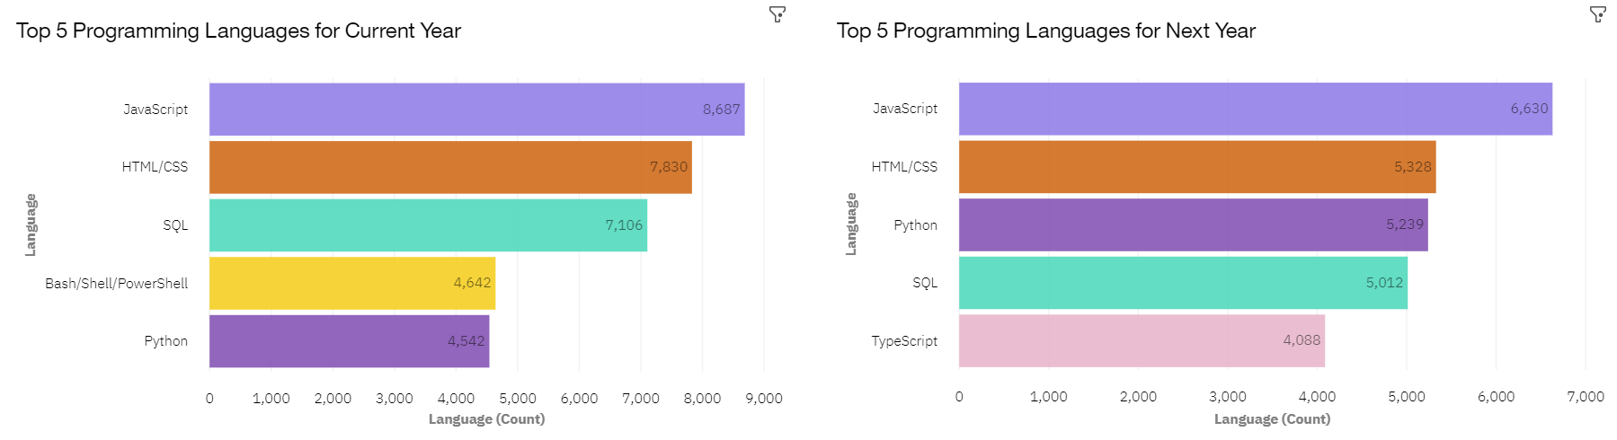
PROGRAMMING LANGUAGE TRENDS

Slide 8
PROGRAMMING LANGUAGE TRENDS - FINDINGS & IMPLICATIONS
Findings
JavaScript and HTML/CSS continue to
be the top two most popular
programming languages for this year
and next.
Python and TypeScript have
gained more interest for next year.
Whereas interest in SQL and
Bash/Shell/PowerShell has decreased.
Implications
Continue to employ a similar number of people skilled in JavaScript and HTML/CSS.
Employ more people skilled in Python and TypeScript.
Employ less people skilled in SQL and Bash/Shell/PowerShell.

Slide 9
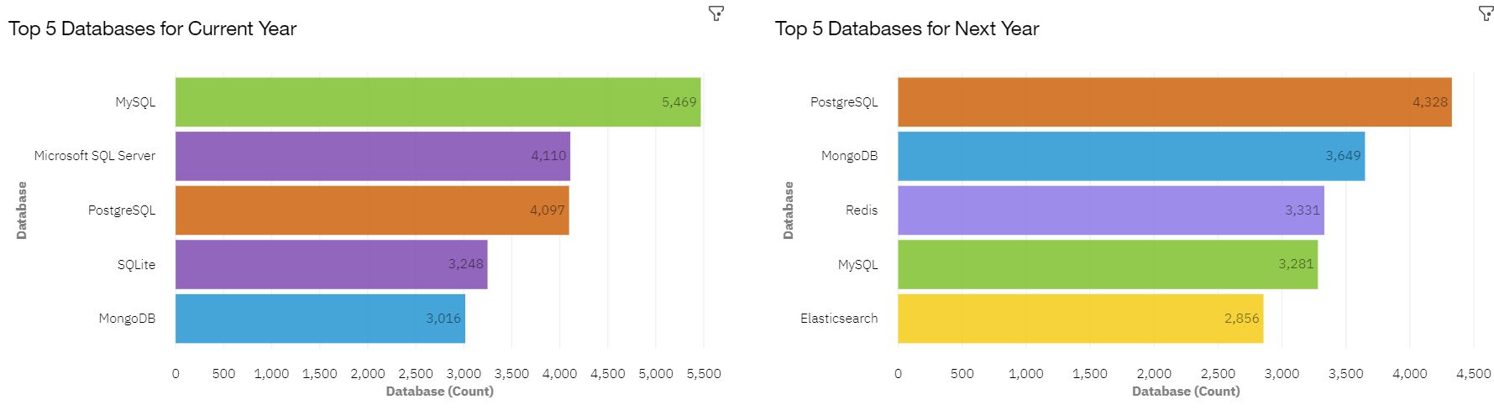
DATABASE TRENDS

Slide 10
DATABASE TRENDS - FINDINGS & IMPLICATIONS
Findings
Interest in MySQL, Microsoft SQL Server and SQLite has decreased for next year.
Interest in PostgreSQL and MongoDB have increased compared to the current year.
There is gained interest in Redis and Elasticsearch for next year.
Implications
Employ less people skilled in MySQL, Microsoft SQL Server and SQLite.
Employ more people skilled in PostgreSQL and MongoDB.
Employ more people skilled in Redis and Elasticsearch.

Slide 11

DASHBOARD
Click here to view the
Cognos dashboard

Slide 12
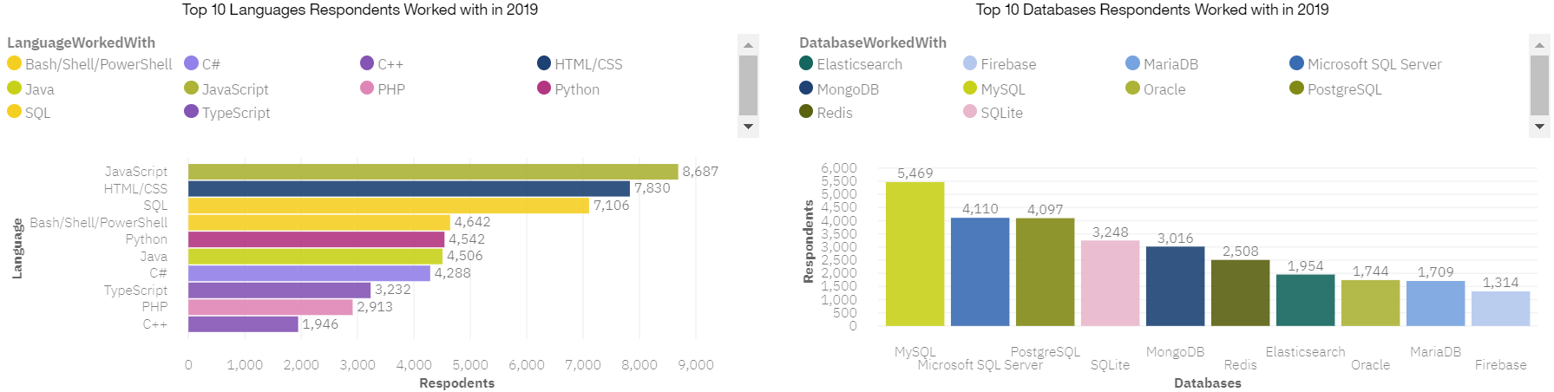
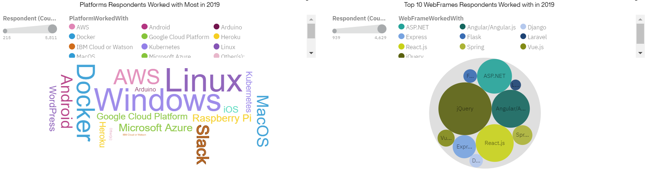
CURRENT TECHNOLOGY USAGE

Slide 13
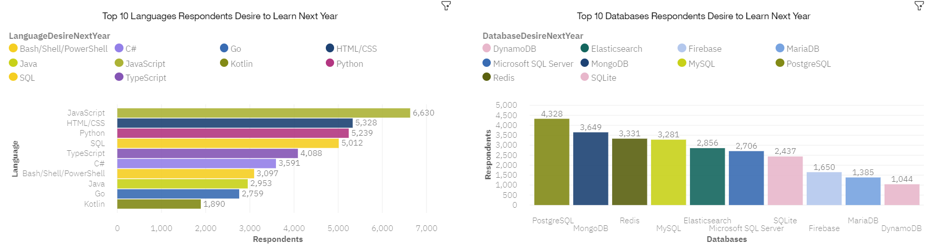
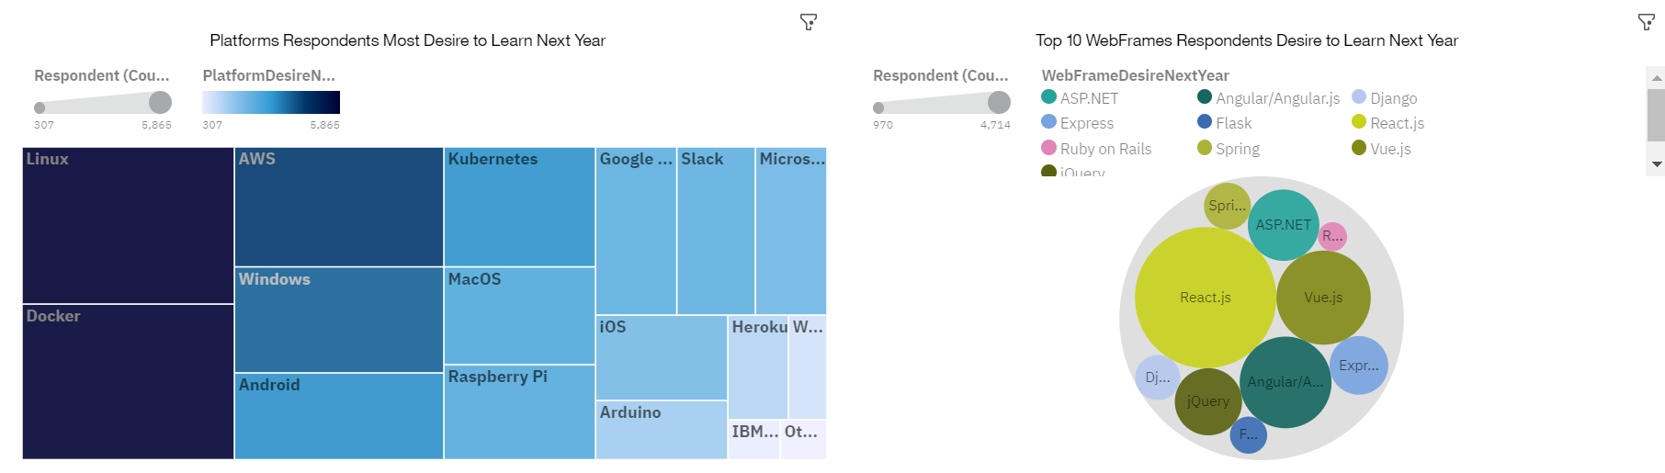
FUTURE TECHNOLOGY TRENDS

Slide 14
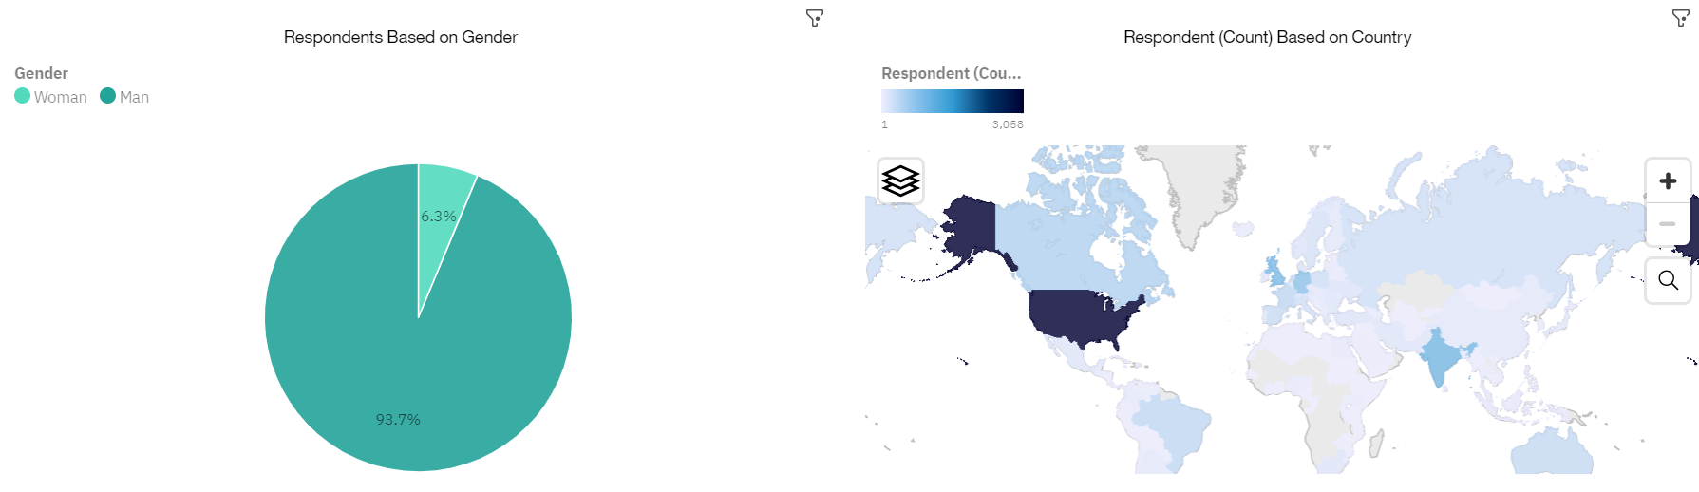
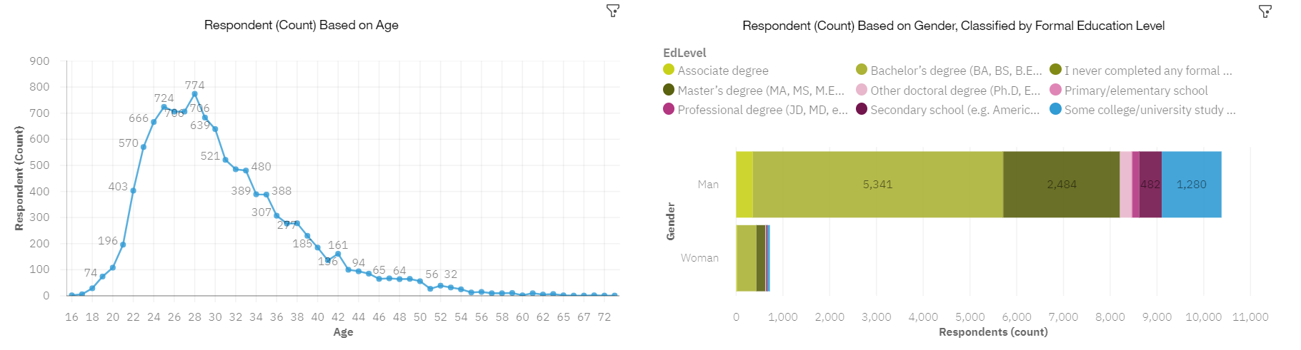
DEMOGRAPHICS

Slide 15
PLATFORM TRENDS - FINDINGS & IMPLICATIONS
Findings
Linux continues to be the top platform for this year and next.
Docker, AWS and Android have gained slightly more interest for next year.
Interest in Windows has dropped slightly.
Interest in Slack has dropped significantly.
Implications
Continue to employ a similar number of people skilled in Linux.
Employ more people skilled in Docker, AWS and Android.
Employ less people skilled in Windows.
Employ less people skilled in Slack.

Slide 16
WEBFRAME TRENDS - FINDINGS & IMPLICATIONS
Findings
Interest in jQuery, Express and Angular/Angular.js has decreased for next year.
Interest in React.js and Vue.js has increased compared to the current year.
Interest in ASP.NET has stayed the same.
Implications
Employ less jQuery, Express and Angular/Angular.js
Employ more React.js and Vue.js
Continue to employ a similar number of people skilled in ASP.NET.

Slide 17
DISCUSSION

Slide 18
OVERALL FINDINGS & IMPLICATIONS
Findings
Programming Languages - TypeScript is gaining significant interest and Python continues to grow as well.
Databases - Redis, Elasticsearch, PostgreSQL and MongoDB are gaining more interest.
Platforms - Interest Slack is dropping significantly.
WebFrames - Vue.js is gaining substantial interest and React.js continues to grow as well.
Implications
Continue to staff enough JavaScript and HTML/CSS but employ more people skilled in TypeScript and Python.
Employ more people skilled in Redis, Elasticsearch, PostgreSQL and MongoDB.
Continue to staff enough Linux, employ more people skilled in Docker, AWS and Android, but make reductions to Slack and Windows.
Continue to staff enough ASP.NET but employ more people skilled in Vue.js and React.js.

Slide 19

CONCLUSION
Carve out budget in order to hire additional staff with skills needed to fill any gaps.
Set aside budget or put a program in place to upskill those already employed.
Make adjustments in staff for those skills no longer in demand.

Slide 20

APPENDIX

Slide 21
GITHUB JOB POSTINGS BY LANGUAGE

Slide 22
POPULAR LANGUAGES BY AVERAGE ANNUAL SALARY

Slide 23
RESOURCES
https://stackoverflow.blog/2019/04/09/the-2019-stack-overflow-developer-survey-results-are-in/
m5_survey_data_demographics.csv and m5_survey_data_technologies_normalised.csv
https://jobs.github.com/api
github-job-postings.xlsx
https://cf-courses-data.s3.us.cloud-object-storage.appdomain.cloud/IBM-DA0321EN-SkillsNetwork/labs/datasets/Programming_Languages.html
popular-languages.csv

Slide 24
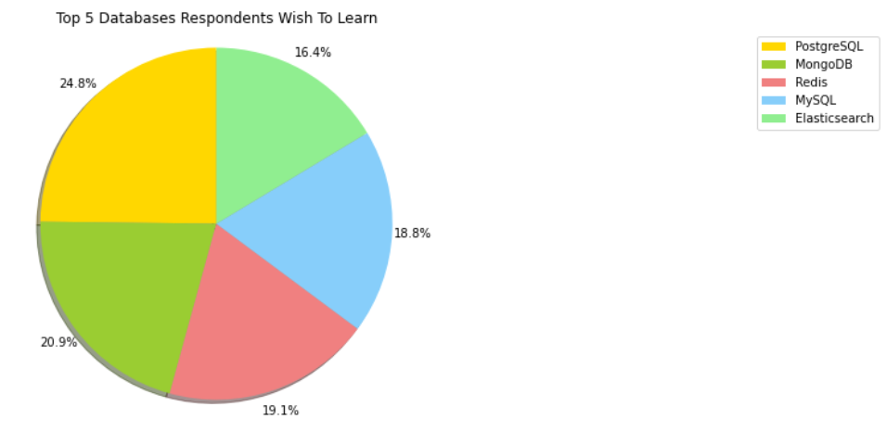
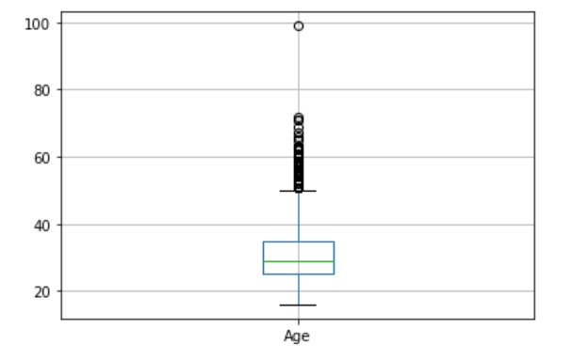
ADDITIONAL VISUALS
Box Plot of Age of Survey Respondents

